Slide 1
Tree
™üúíöøðßáå€æñ

Slide 2
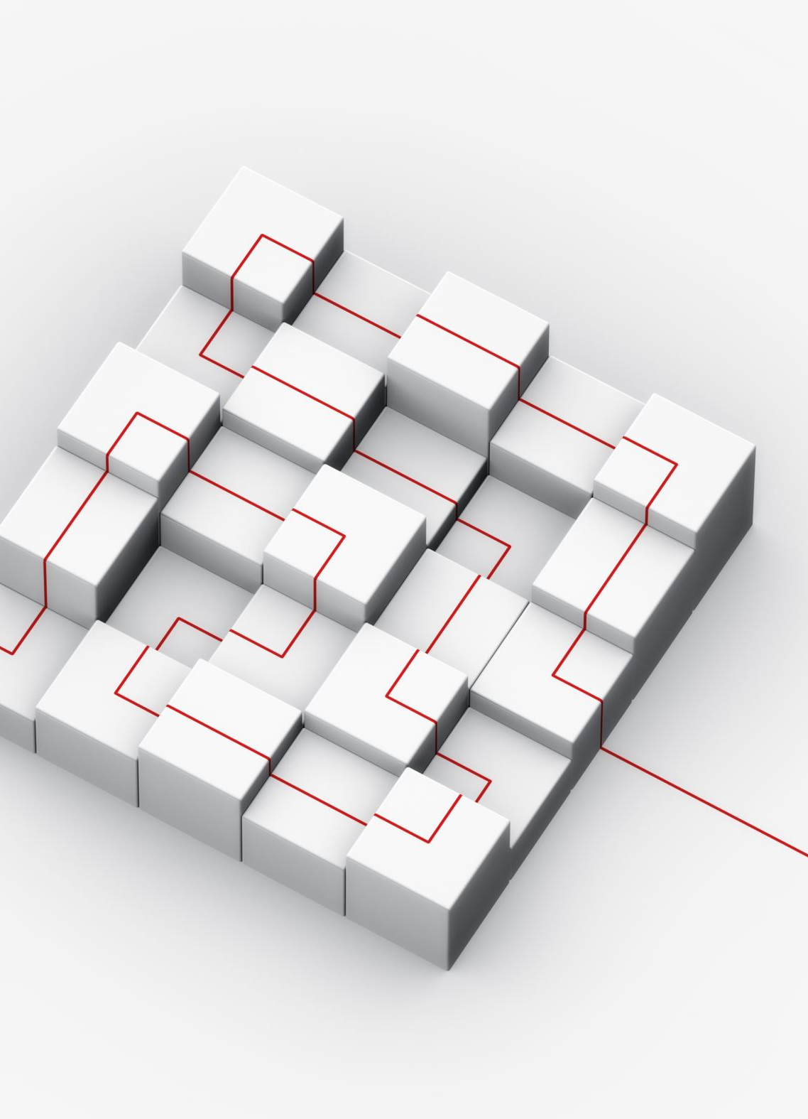
Tree
data structure is said to be linear if its elements form a sequence or a linear list.
Previous linear data structures that we have studied like an array, stacks, queues and linked lists organize data in linear order.
A data structure is said to be non linear if its elements form a hierarchical classification where, data items appear at various levels.

Slide 3
Tree
Trees and Graphs are widely used non-linear data structures. Tree and graph structures represent hierarchical relationship between individual data elements.
Tree is hierarchical collection of nodes. One of the nodes, known as the root, is at the top of the hierarchy. Each node can have at most one link coming into it. The node where the link originates is called the parent node.
The root node has no parent. The links leaving a node (any number of links are allowed) point to child nodes

Slide 4
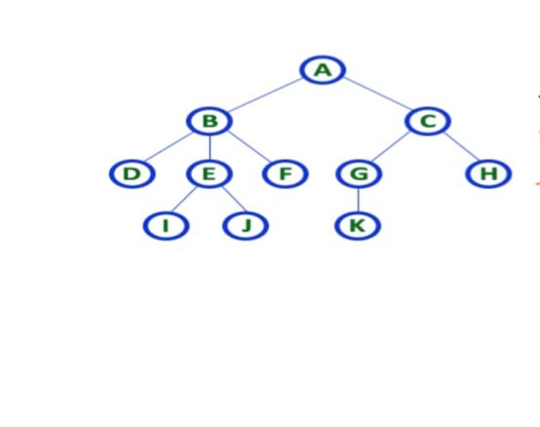
Tree

Slide 5
Terminologies
In a Tree, Every individual element is called as Node. Node in a tree data structure, stores the actual data of that particular element and link to next element in hierarchical structure
Root:
In a tree data structure, the first node is called as Root Node. Every tree must have root node. We can say that root node is the origin of tree data structure. In any tree, there must be only one root node. We never have multiple root nodes in a tree. In above tree, A is a Root node

Slide 6
Terminologies
Edge
In a tree data structure, the connecting link between any two nodes is called as EDGE. In a tree with 'N' number of nodes there will be a maximum of 'N-1' number of edges.
Parent
In a tree data structure, the node which is predecessor of any node is called as PARENT NODE. In simple words, the node which has branch from it to any other node is called as parent node. Parent node can also be defined as "The node which has child / children". e.g., Parent (A,B,C,E).

Slide 7
Terminologies
Child
the node which is descendant of any node is called as CHILD Node. the node which has a link from its parent node is called as child node. In a tree, any parent node can have any number of child nodes. In a tree, all the nodes except root are child nodes.e.g., Children of E are (I,J).
Siblings
In a tree data structure, nodes which belong to same Parent are called as SIBLINGS. the nodes with same parent are called as Sibling nodes. Ex: Siblings (B,C)

Slide 8
Terminologies
Leaf
In a tree data structure, the node which does not have a child (or) node with degree zero is called as LEAF Node. a leaf is a node with no child.In a tree data structure, the leaf nodes are also called as External Nodes. External node is also a node with no child. In a tree, leaf node is also called as ‘Terminal’ node. Ex: (D, I, J, K, H)
Internal Nodes
Ina tree data structure, nodes other than leaf nodes are called as Internal Nodes. The root node is also said to be Internal Node if the tree has more than one node. Internal nodes are also called as Non-Terminal’ nodes. Ex:B,C,D,E,H

Slide 9
Terminologies
Degree
total number of children of a node is called as DEGREE of that Node. In simple words, the Degree of a node is total number of children it has. The highest degree of a node among all the nodes in a tree is called as ‘Degree of Tree’
Level
in a tree each step from top to bottom is called as a Level and the Level count starts with ‘0’ and incremented by one at each level (Step).

Slide 10
Terminologies
HEIGHT
Total number of edges from leaf node to a particular node in the longest path is called as HEIGHT of that Node. In a tree, height of the root node is said to be height of the tree. In a tree, height of all leaf nodes is ‘0’.
Path
In a tree data structure, the sequence of Nodes and Edges from one node to another node is called as PATH between that two Nodes. Length of a Path is total number of nodes in that path. In below example the path A - B - E - J has length 4.

Slide 11
Terminologies
Sub Tree
In a tree data structure, each child from a node forms a subtree recursively. Every child node will form a subtree on its parent node.
Depth
In a tree data structure, the total number of edges from root node to a particular node is called as DEPTH of that Node. In a tree, the total number of edges from root node to a leaf node in the longest path is said to be Depth of the tree. In simple words, the highest depth of any leaf node in a tree is said to be depth of that tree. In a tree, depth of the root node is '0'.

Slide 12
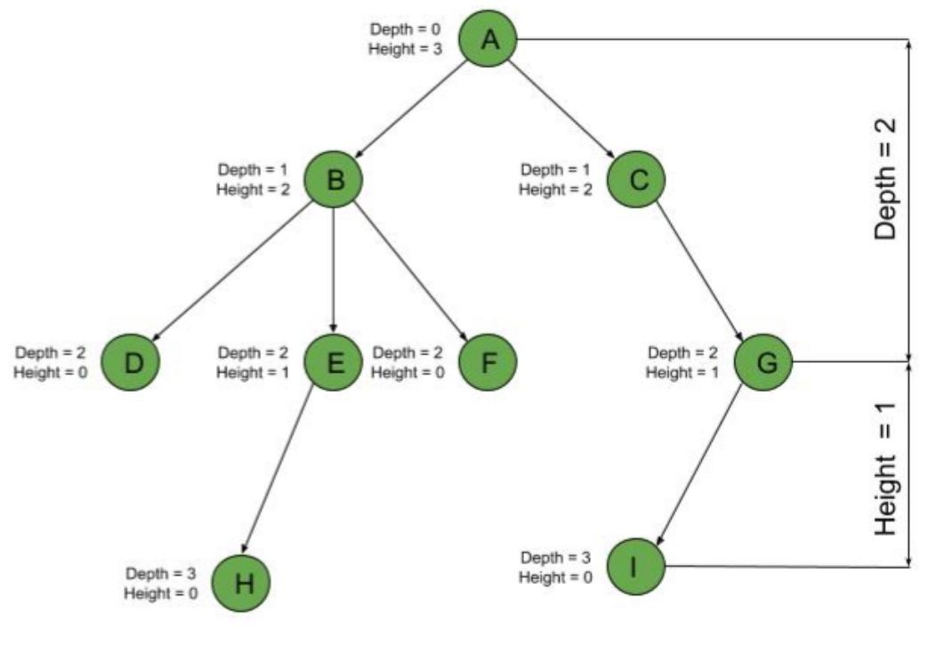
Terminologies

Slide 13
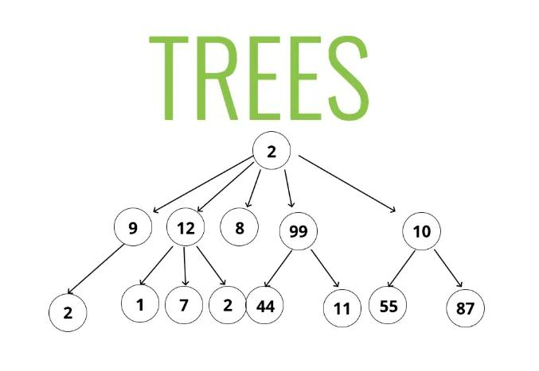
Terminologies

Slide 14
Different types of Tree
Binary Trees
Binary tree is a special type of tree data structure in which every node can have a maximum of 2 children.
tree in which every node can have a maximum of two children is called as Binary Tree.
In a binary tree, every node can have either 0 children or 1 child or 2 children but not more than 2 children.

Slide 15
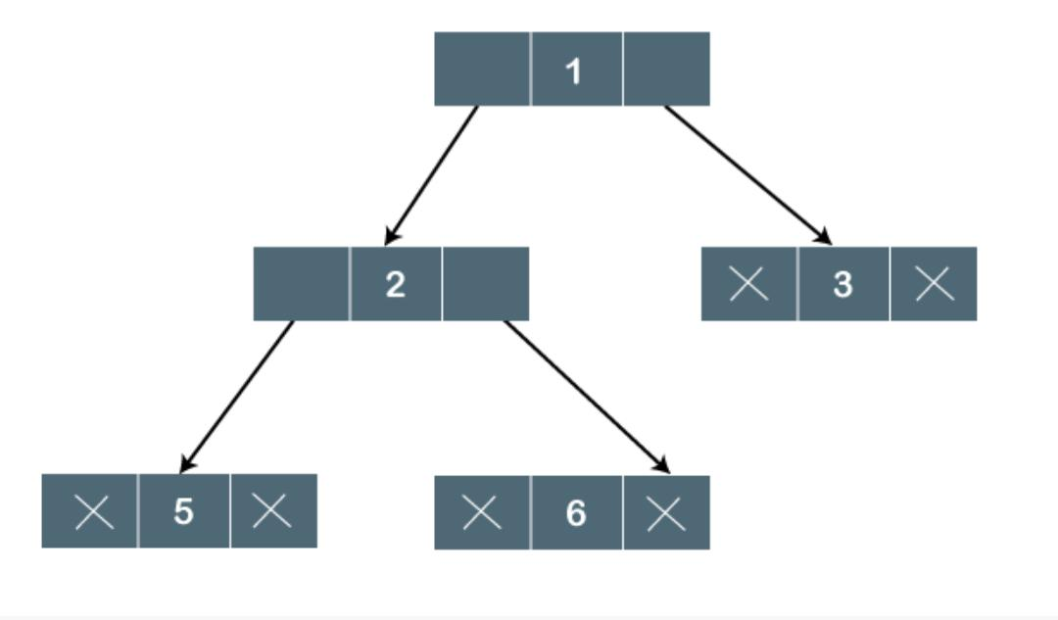
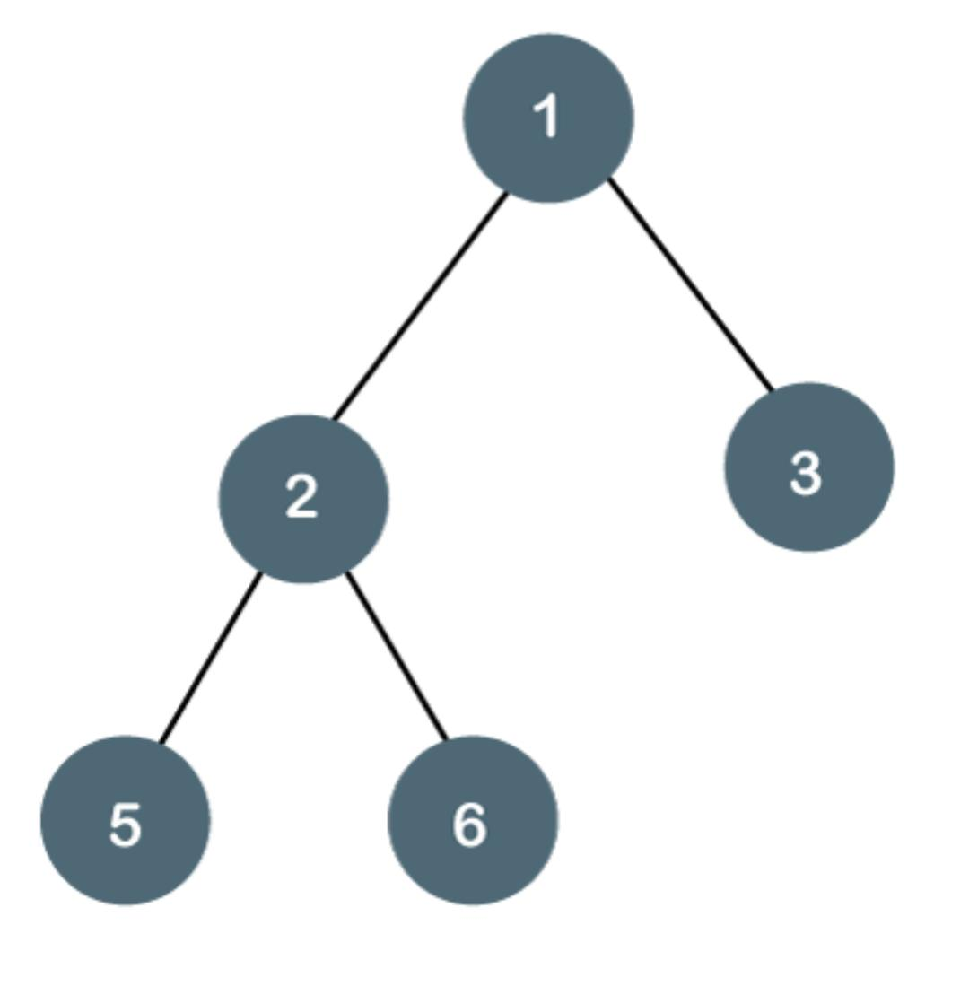
Binary Tree

Slide 16
Properties of Binary Tree
At each level of i, the maximum number of nodes is 2^i. In general, the maximum number of nodes possible at height h is 2^(h+1) -1. The minimum number of nodes possible at height h is equal to h+1
total number of edges in a full binary tree with n node is n - 1.

Slide 17
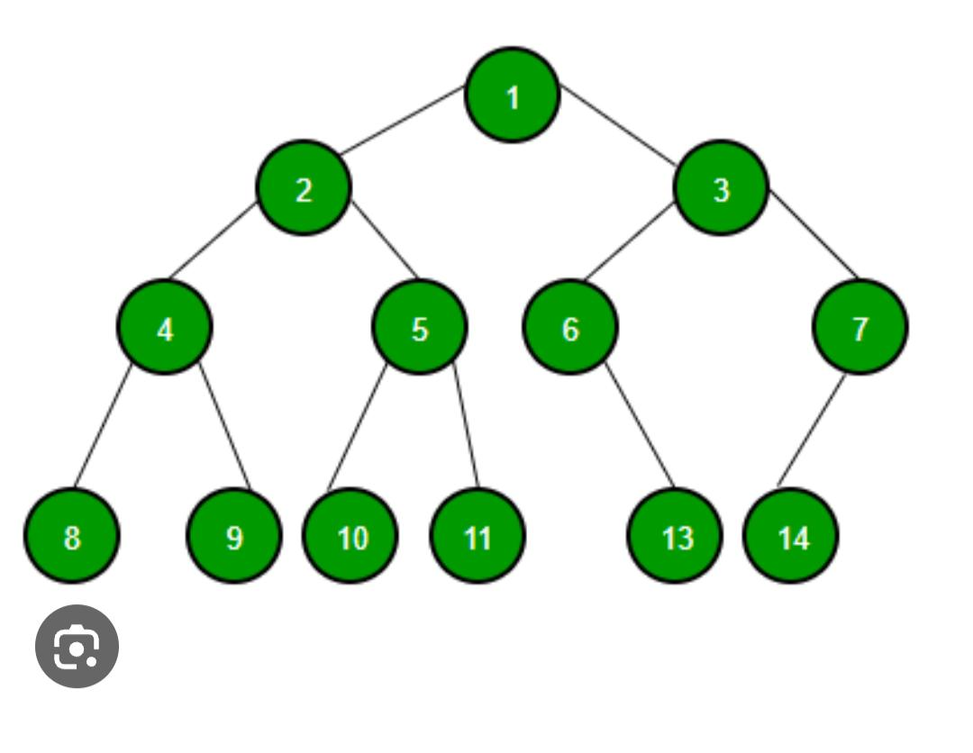
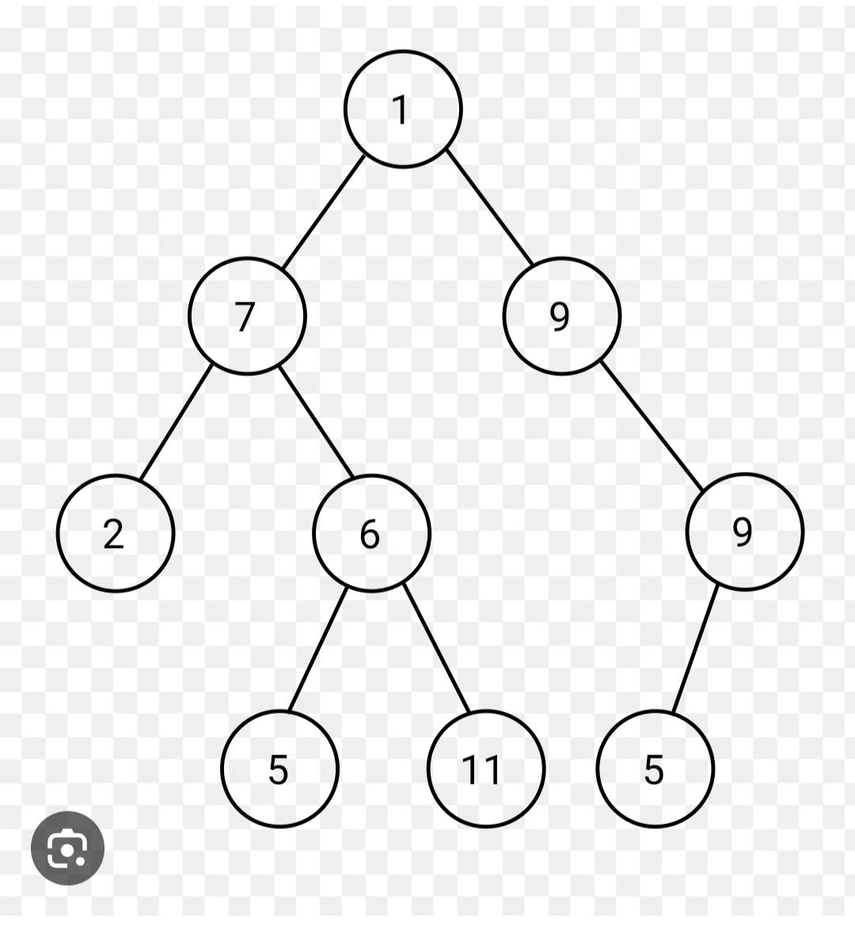

Slide 18
Traversal of Binary Trees
Tree traversal’ means traversing or visiting each node of a tree.
Preorder traversal
First root node is visited after that the left subtree is traversed recursively, and finally, right subtree is recursively traversed.
As the root node is traversed before (or pre) the left and right subtree, it is called preorder traversal
in a preorder traversal, each node is visited before both of its subtrees

Slide 19
Traversal of Binary Trees
Until all nodes of the tree are not visited Step 1 – Visit the root node Step 2 – Traverse the left subtree recursively. Step 3 – Traverse the right subtree recursively.

Slide 20
Traversal of Binary Trees
start applying the preorder traversal on the above tree. First, we traverse the root node A; after that, move to its left subtree B, which will also be traversed in preorder.
for left subtree B, first, the root node B is traversed itself; after that, its left subtree D is traversed.
Since node D does not have any children, move to right subtree E.
As node E also does not have any children, the traversal of the left subtree of root node A is completed.

Slide 21
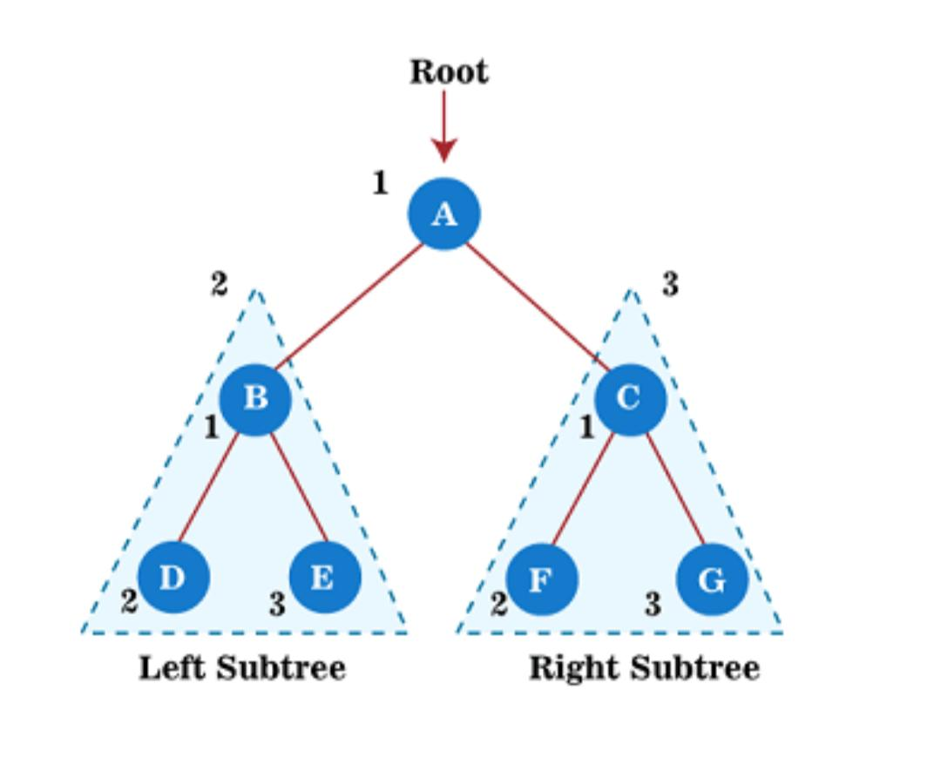
Traversal of Binary Trees

Slide 22
Traversal of Binary Trees
move towards the right subtree of root node A that is C. So, for right subtree C, first the root node C has traversed itself; after that, its left subtree F is traversed.
Since node F does not have any children, move to the right subtree G.
As node G also does not have any children, traversal of the right subtree of root node A is completed
A → B → D → E → C → F → G

Slide 23
Traversal of Binary Trees
Postorder traversal
This technique follows the ‘left-right root’ policy. It means that the first left subtree of the root node is traversed, after that recursively traverses the right subtree, and finally, the root node is traversed.
As the root node is traversed after (or post) the left and right subtree, it is called postorder traversal
in a postorder traversal, each node is visited after both of its subtrees.

Slide 24
Traversal of Binary Trees
Until all nodes of the tree are not visited Step 1 – Traverse the left subtree recursively. Step 2 – Traverse the right subtree recursively. Step 3 – Visit the root node.

Slide 25
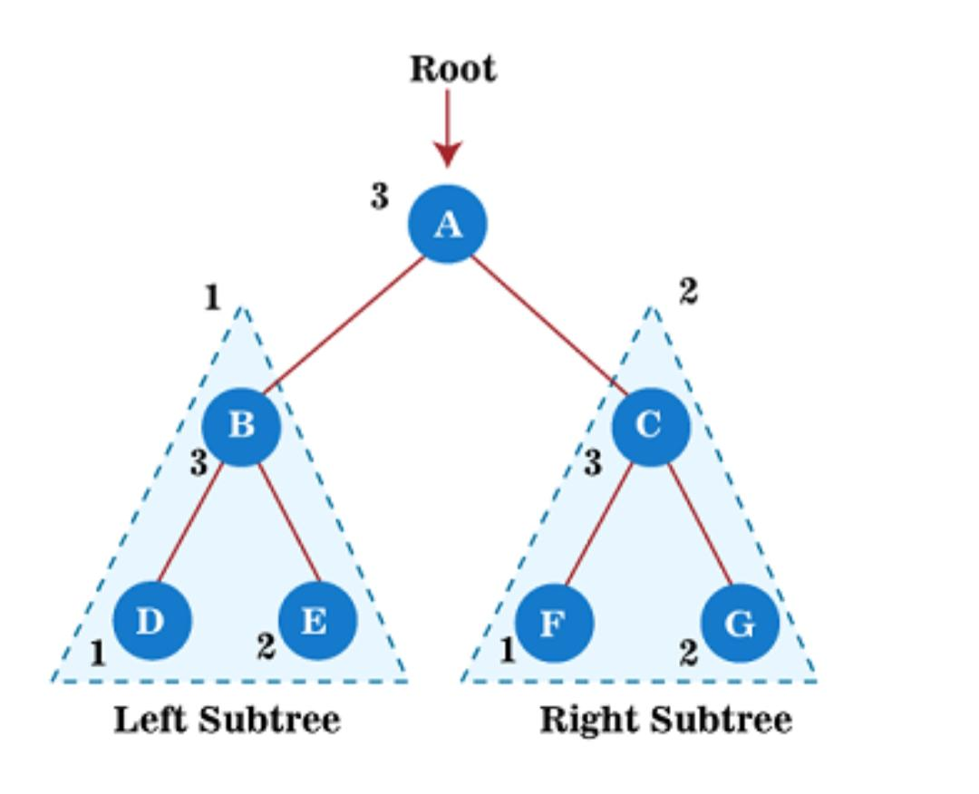
Traversal of Binary Trees

Slide 26
Traversal of Binary Trees
The output of the postorder traversal of the above tree is – D → E → B → F → G → C → A

Slide 27
Traversal of Binary Trees
Until all nodes of the tree are not visited Step 1 – Traverse the left subtree recursively. Step 2 – Visit the root node. Step 3 – Traverse the right subtree recursively.

Slide 28
Traversal of Binary Trees
Inorder traversal
This technique follows the 'left root right' policy. It means that first left subtree is visited after that root node is traversed, and finally, the right subtree is traversed.
As the root node is traversed between the left and right subtree, it is named inorder traversal.

Slide 29

Traversal of Binary Trees
The output of the inorder traversal of the above tree is – D → B → E → A → F → C → G

Slide 30
Binary search trees
Binary search tree is a data structure that quickly allows us to maintain a sorted list of numbers.
It is called a binary tree because each tree node has a maximum of two children.
It is called a search tree because it can be used to search for the presence of a number in time.

Slide 31
Binary search trees
The properties that separate a binary search tree
All nodes of left subtree are less than the root node
All nodes of right subtree are more than the root node
Both subtrees of each node are also BSTs i.e. they have the above two properties

Slide 32
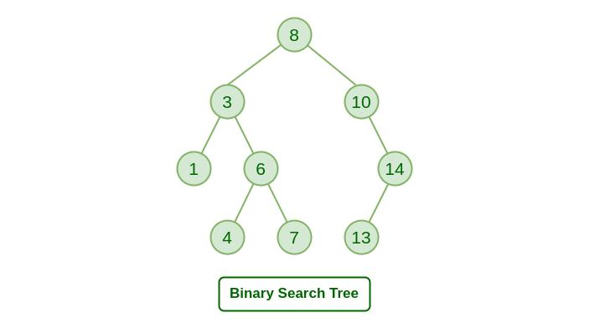
Binary search trees

Slide 33
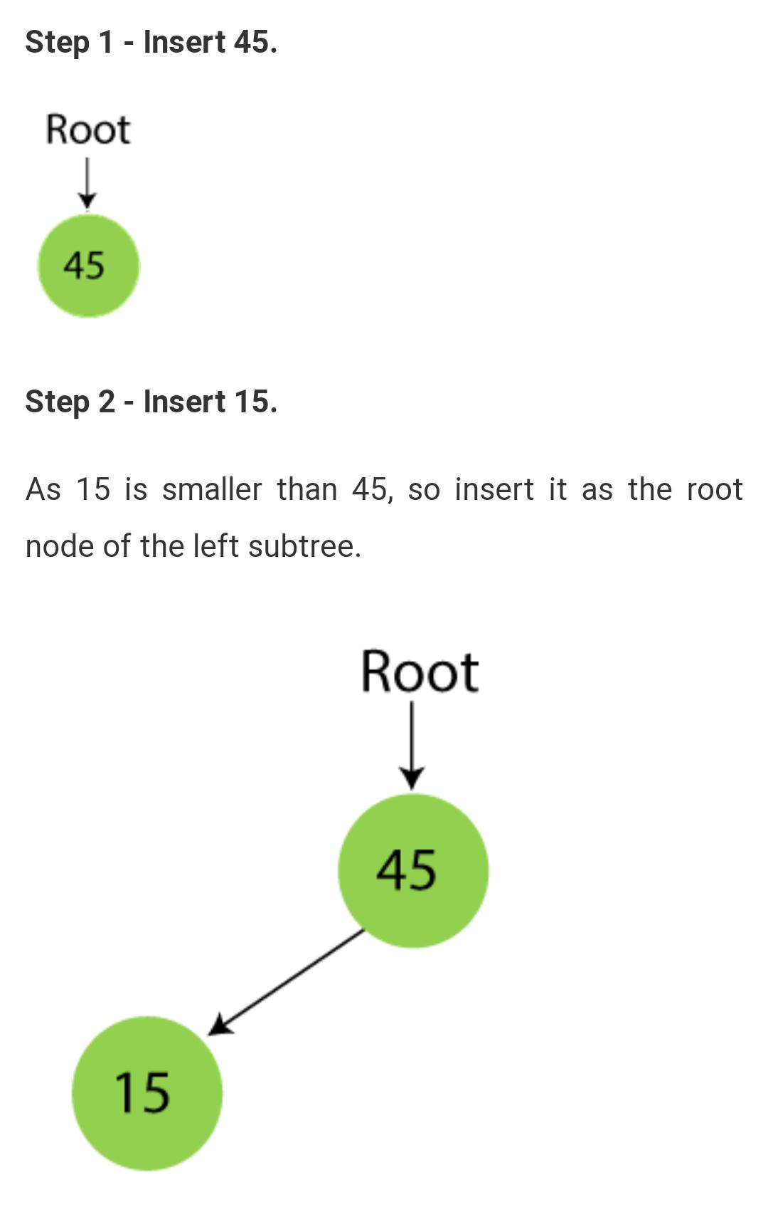
Binary search tree
45, 15, 79, 90, 10, 55, 12, 20, 50

Slide 34
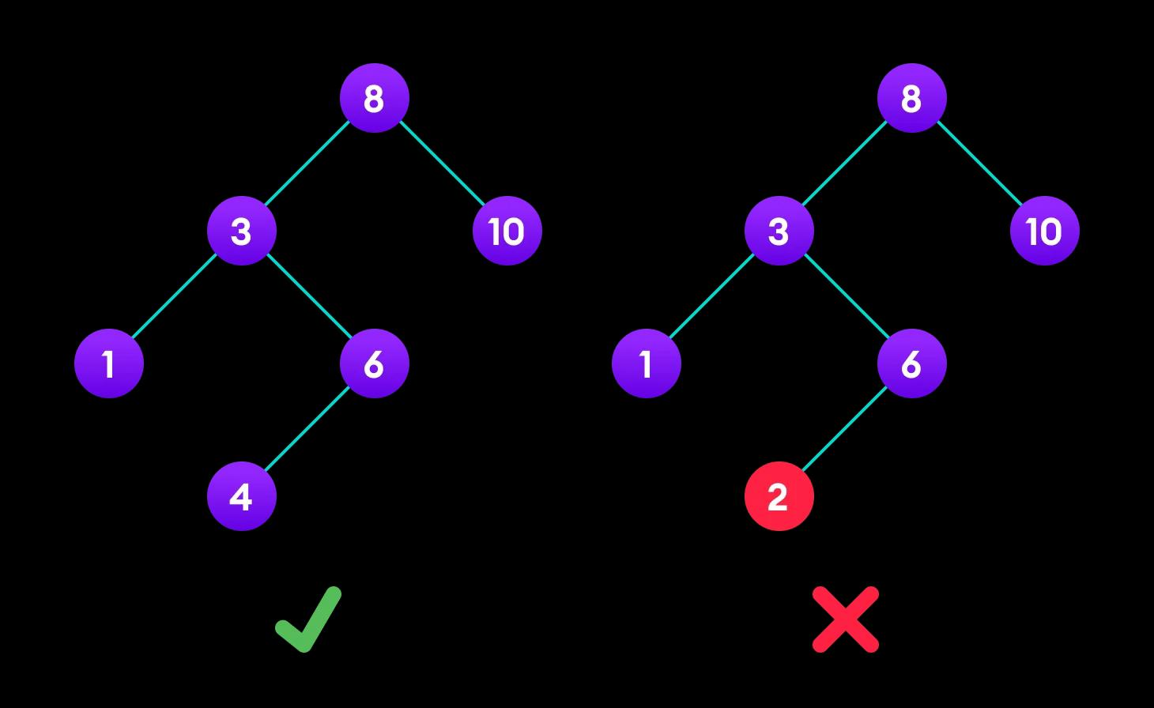
Binary search trees

Slide 35

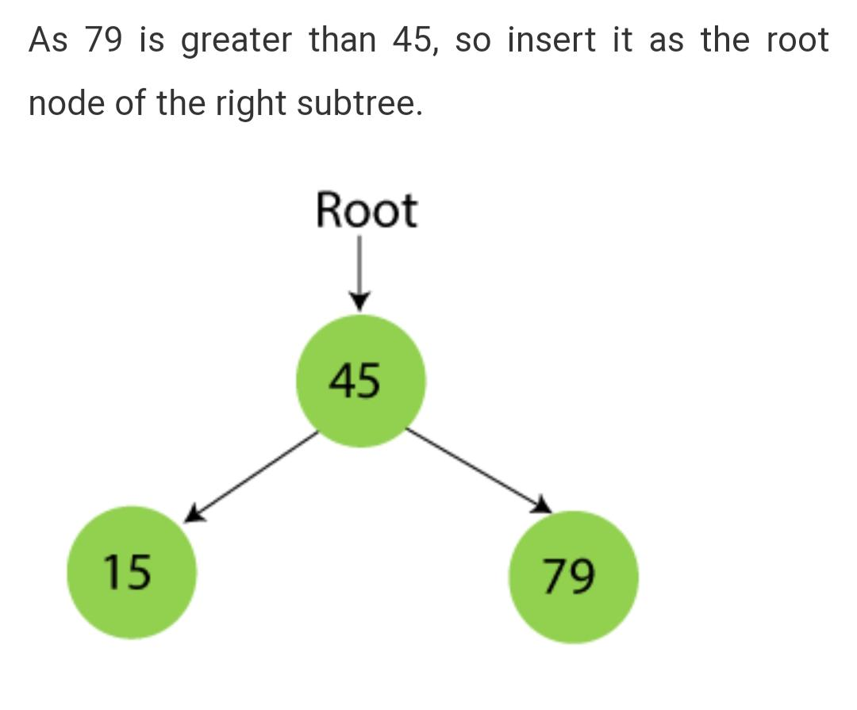
Binary search tree

Slide 36
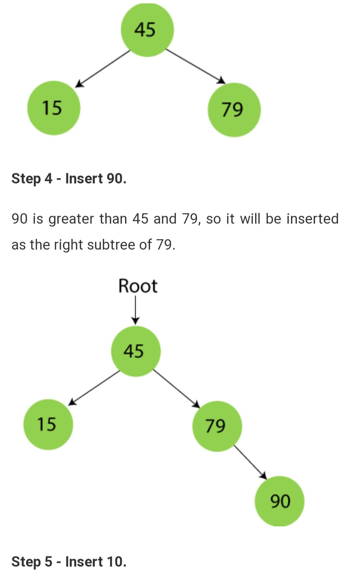
Binary search tree
Insert 90

Slide 37
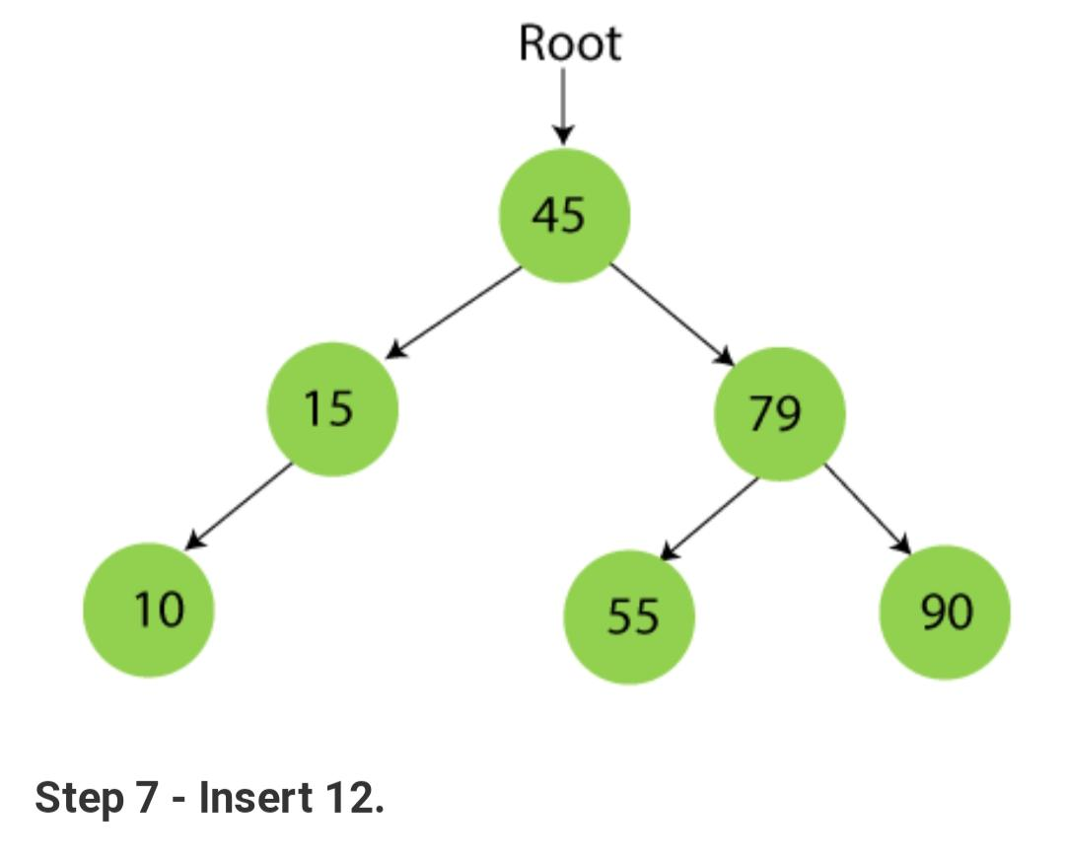
Binary search tree

Slide 38
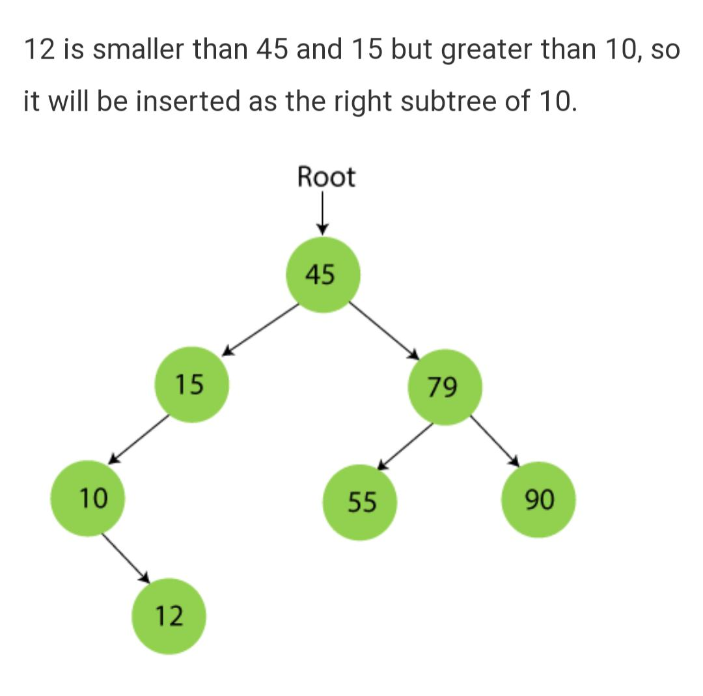
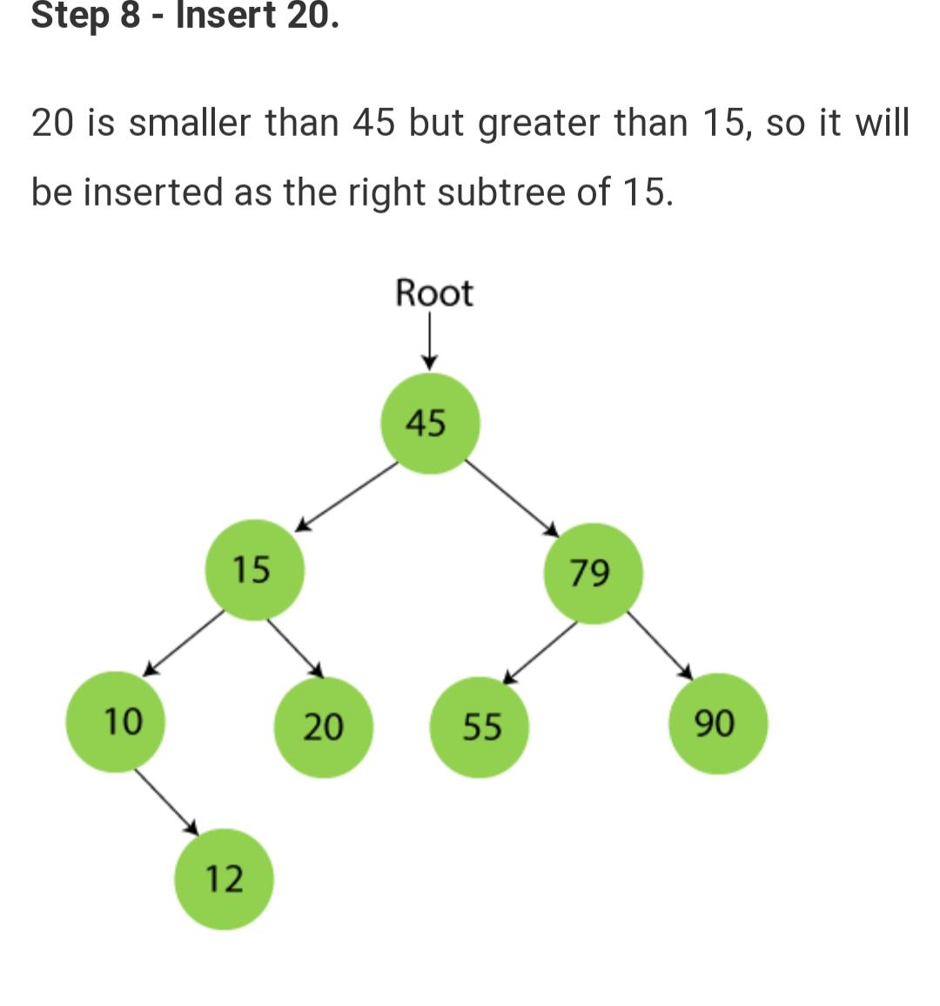
Binary search tree

Slide 39
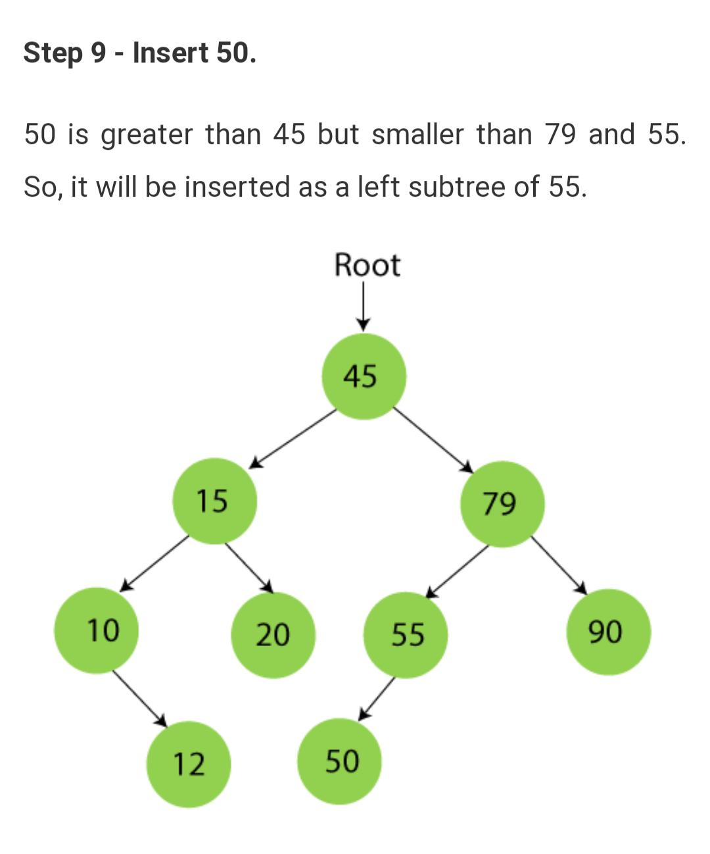
Binary search tree

Slide 40
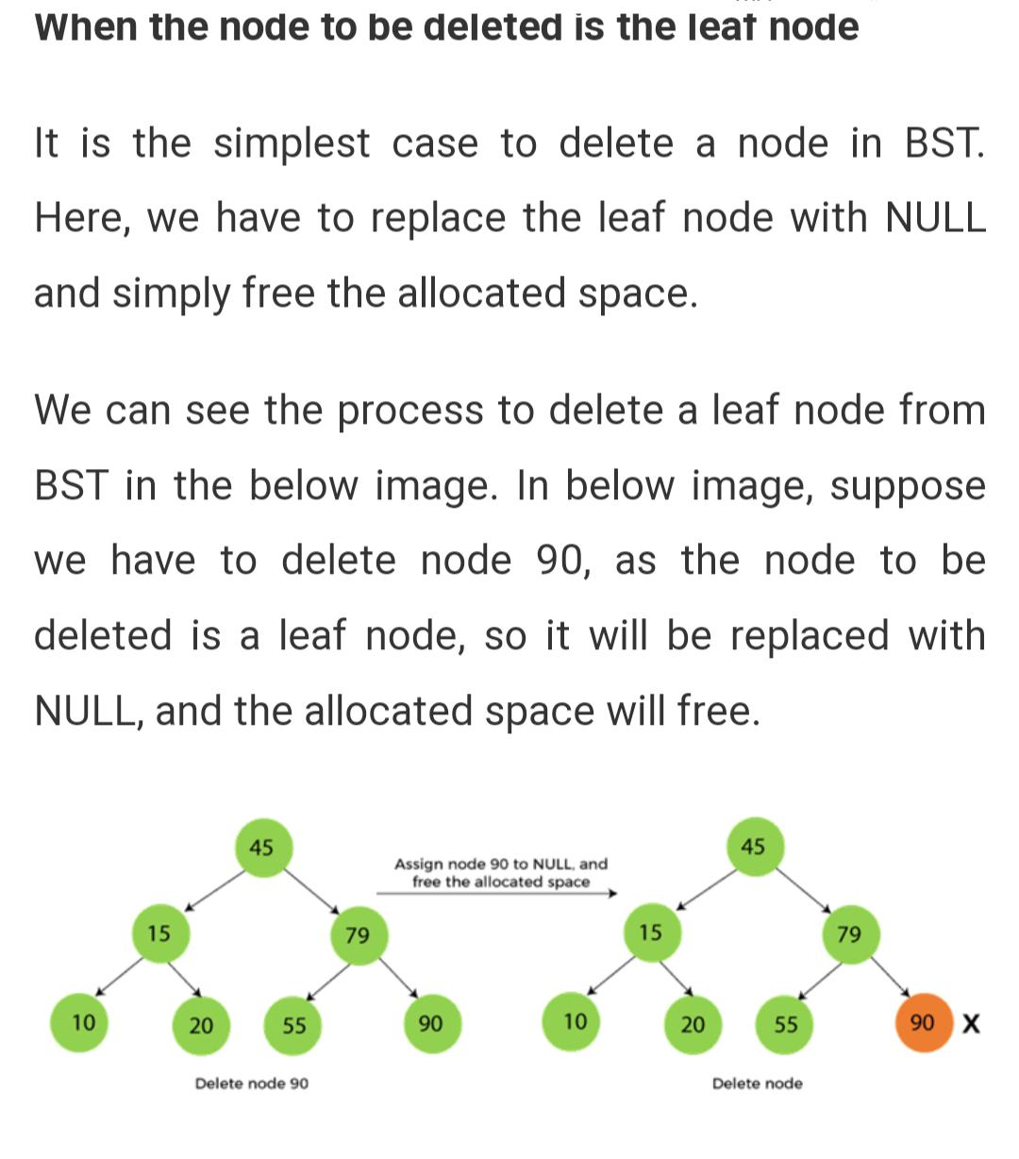
Deletion

Slide 41
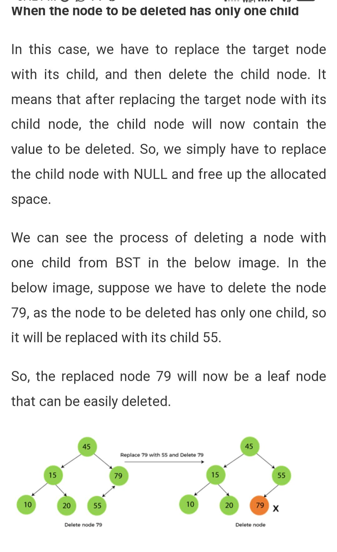
Deletion

Slide 42
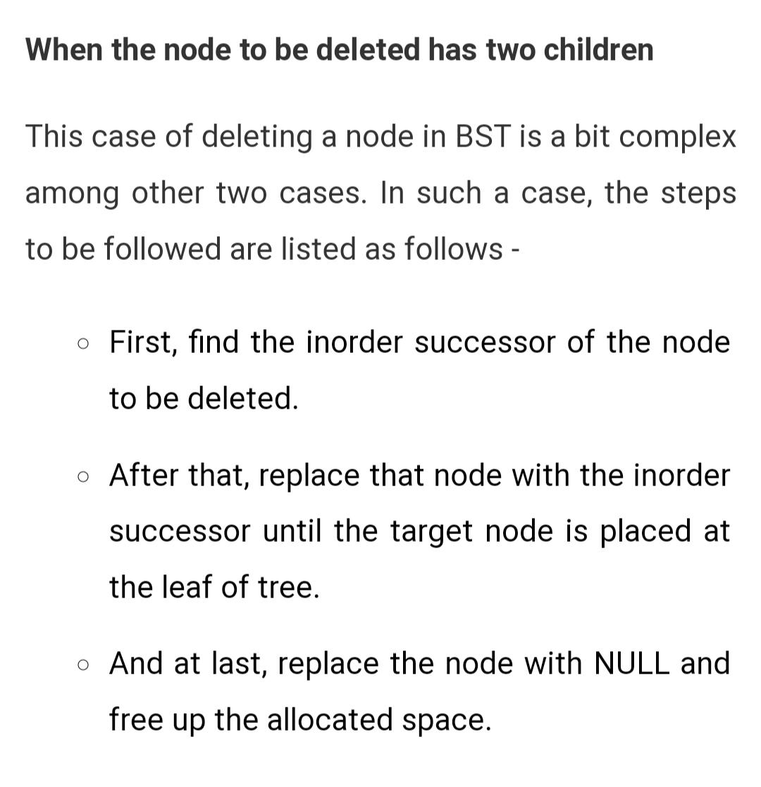
Deletion
Replace with inorder successor or predecessor

Slide 43
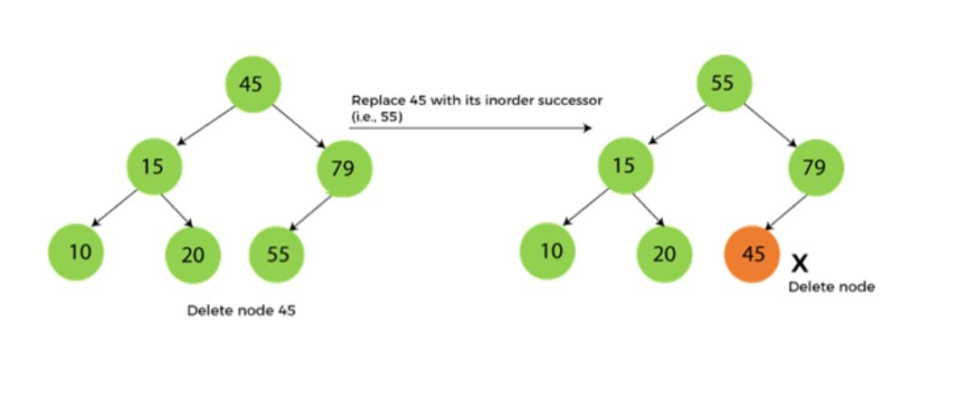
Deletion

Slide 44
AVL Tree
AVL Tree is invented by GM Adelson – Velsky and EM Landis in 1962. The tree is named AVL in honour of its inventors.
defined as height balanced binary search tree in which each node is associated with a balance factor which is calculated by subtracting the height of its right sub-tree from that of its left sub-tree.
Tree is said to be balanced if balance factor of each node is in between -1 to 1, otherwise, the tree will be unbalanced and need to be balanced

Slide 45
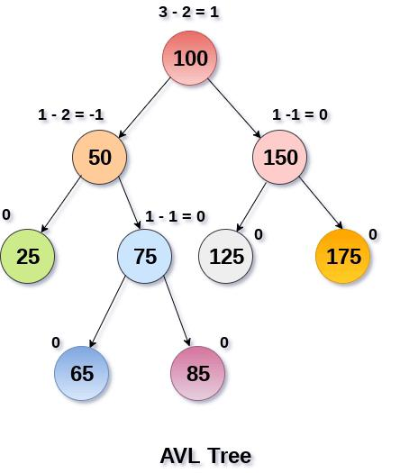
AVL Tree
Balance Factor (k) = height (left(k)) – height (right(k))

Slide 46
AVL Rotations
perform rotation in AVL tree only in case if Balance Factor is other than -1, 0, and 1.

Slide 47
RR Rotation
When BST becomes unbalanced, due to a node is inserted into the right subtree of the right subtree of A, then we perform RR rotation, RR rotation is an anticlockwise rotation
, node A has balance factor -2 because a node C is inserted in the right subtree of A right subtree.

Slide 48
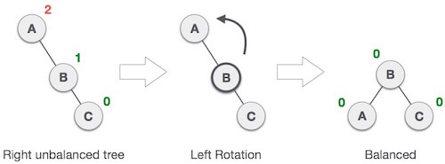
RR Rotation

Slide 49
LL Rotation
When BST becomes unbalanced, due to a node is inserted into the left subtree of the left subtree of C, then we perform LL rotation, LL rotation is clockwise rotation
node C has balance factor 2 because a node A is inserted in the left subtree of C left subtree.

Slide 50
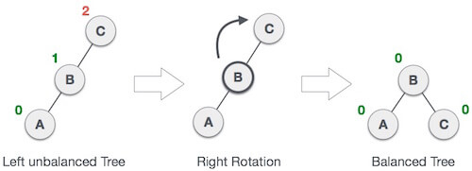
LL Rotation

Slide 51

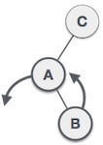
Lr rotation
node B has been inserted into the right subtree of A the left subtree of C, because of which C has become an unbalanced node having balance factor 2. This case is L R rotation where: Inserted node is in the right subtree of left subtree of C
LR rotation = RR + LL rotation, hence RR (anticlockwise) on subtree rooted at A is performed first. By doing RR rotation, node A, has become the left subtree of B.

Slide 52
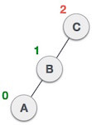
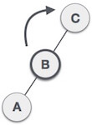
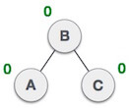
Lr rotation
After performing RR rotation, node C is still unbalanced, i.e., having balance factor 2, as inserted node A is in the left of left of C
Now we perform LL clockwise rotation on full tree, i.e. on node C. node C has now become the right subtree of node B, A is left subtree of B
Balance factor of each node is now either -1, 0, or 1, i.e. BST is balanced now.

Slide 53

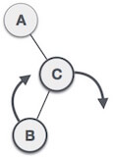
Rl rotation
node B has been inserted into the left subtree of C the right subtree of A, because of which A has become an unbalanced node having balance factor - 2. This case is RL rotation where: Inserted node is in the left subtree of right subtree of A
RL rotation = LL rotation + RR rotation, hence, LL (clockwise) on subtree rooted at C is performed first. By doing RR rotation, node C has become the right subtree

Slide 54
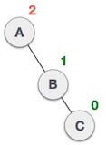
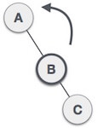
Rl rotation
After performing LL rotation, node A is still unbalanced, i.e. having balance factor -2, which is because of the right-subtree of the right-subtree node A.
Now we perform RR rotation (anticlockwise rotation) on full tree, i.e. on node A. node C has now become the right subtree of node B, and node A has become the left subtree of B.

Slide 55
Rl rotation
Balance factor of each node is now either -1, 0, or 1, i.e., BST is balanced now.

Slide 56
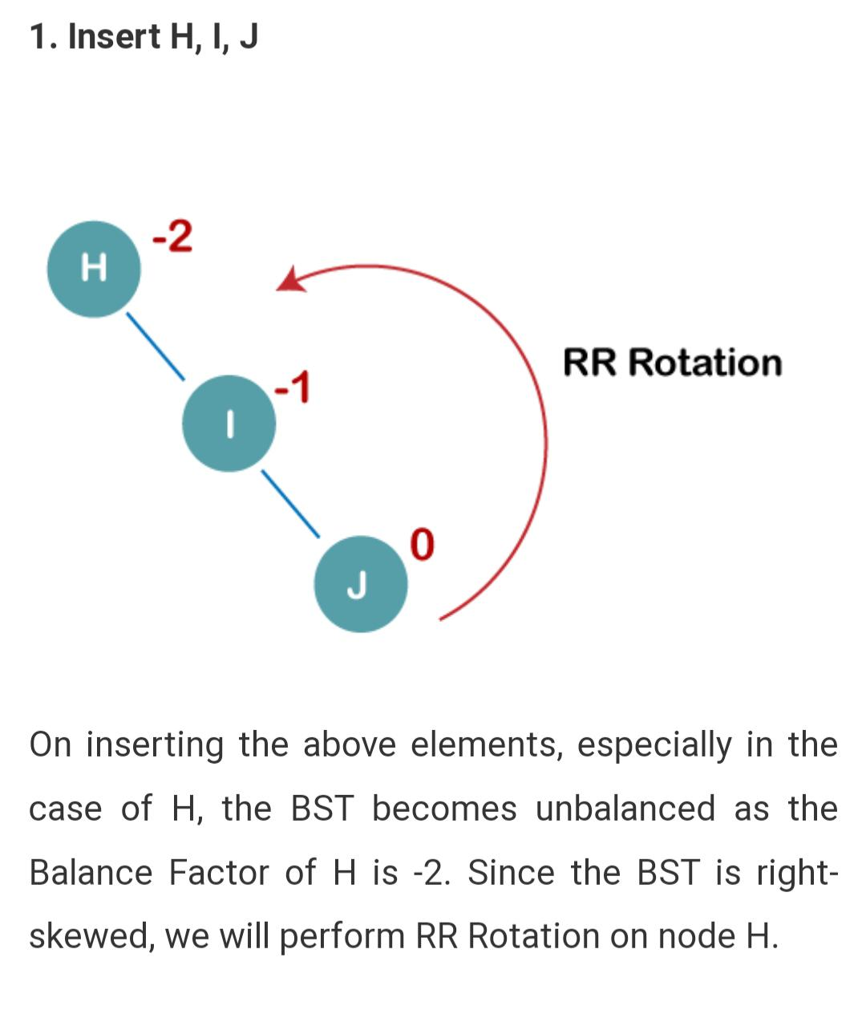
Construct AVL Tree
1. Insert H, I, J

Slide 57
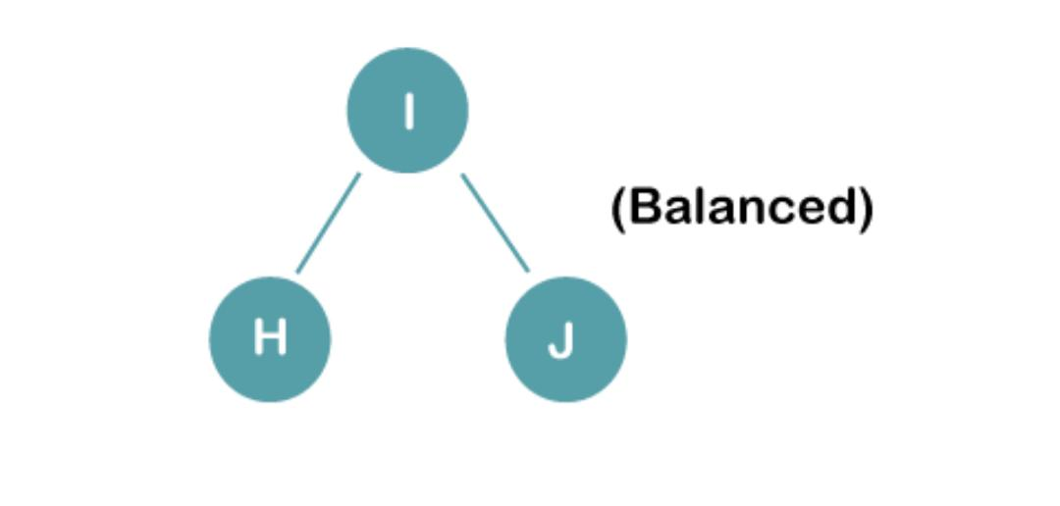
Construct AVL Tree

Slide 58
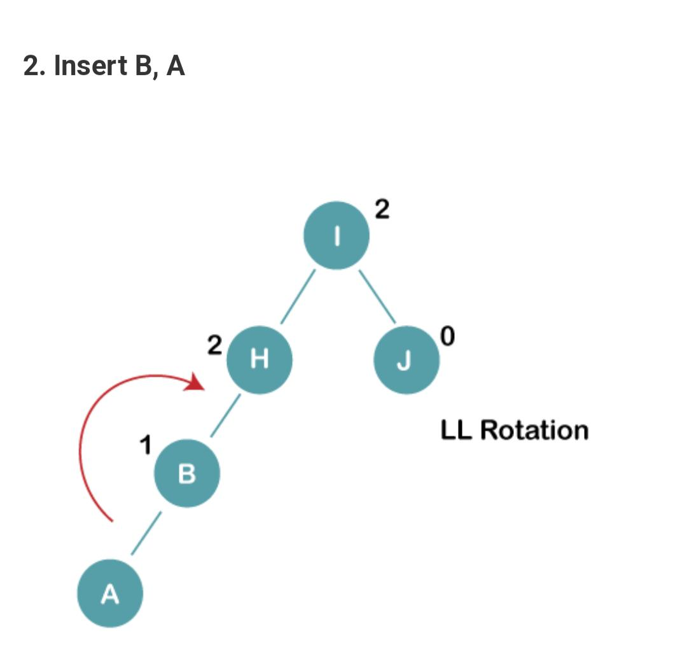
Construct AVL Tree

Slide 59
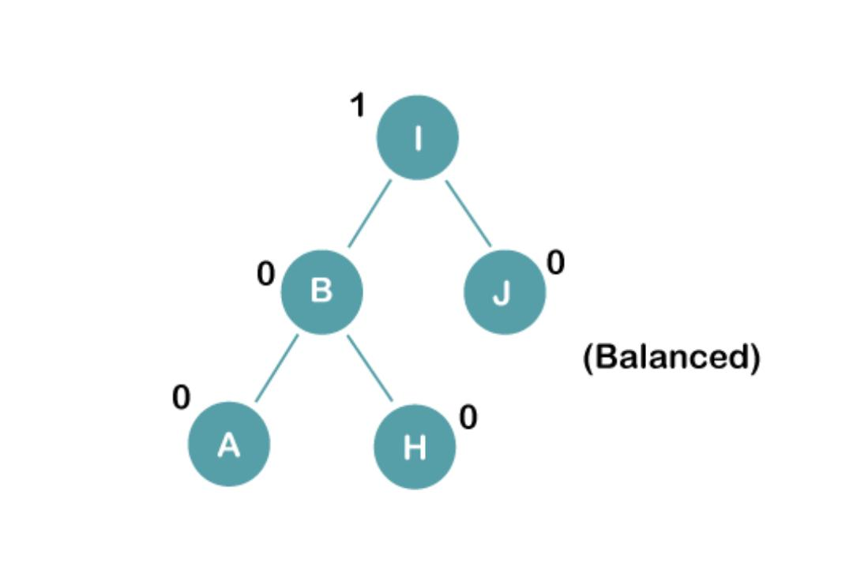
Construct AVL Tree

Slide 60
HEAP Tree
heap is a complete binary tree, and the binary tree is a tree in which the node can have utmost two children.
complete binary tree is a binary tree in which all the levels except the last level, i.e., leaf node should be completely filled, and all the nodes should be left-justified.

Slide 61
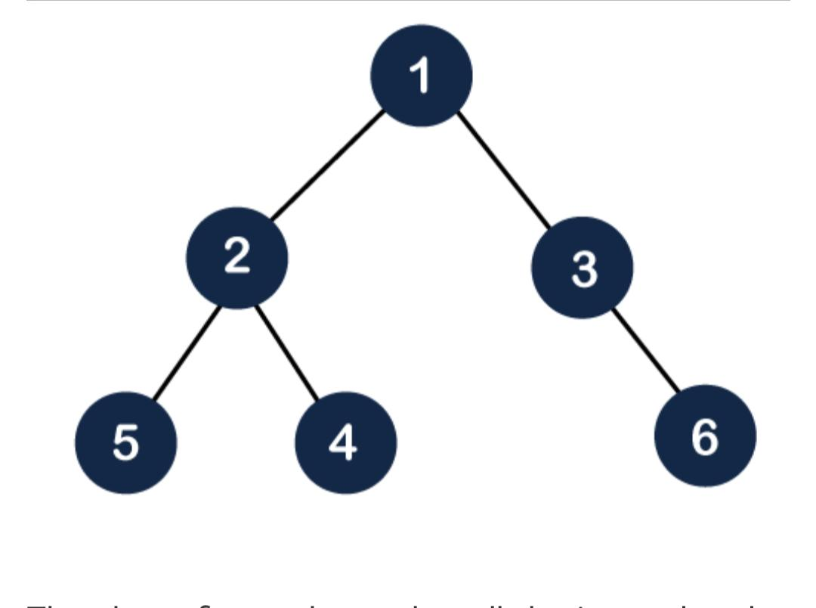
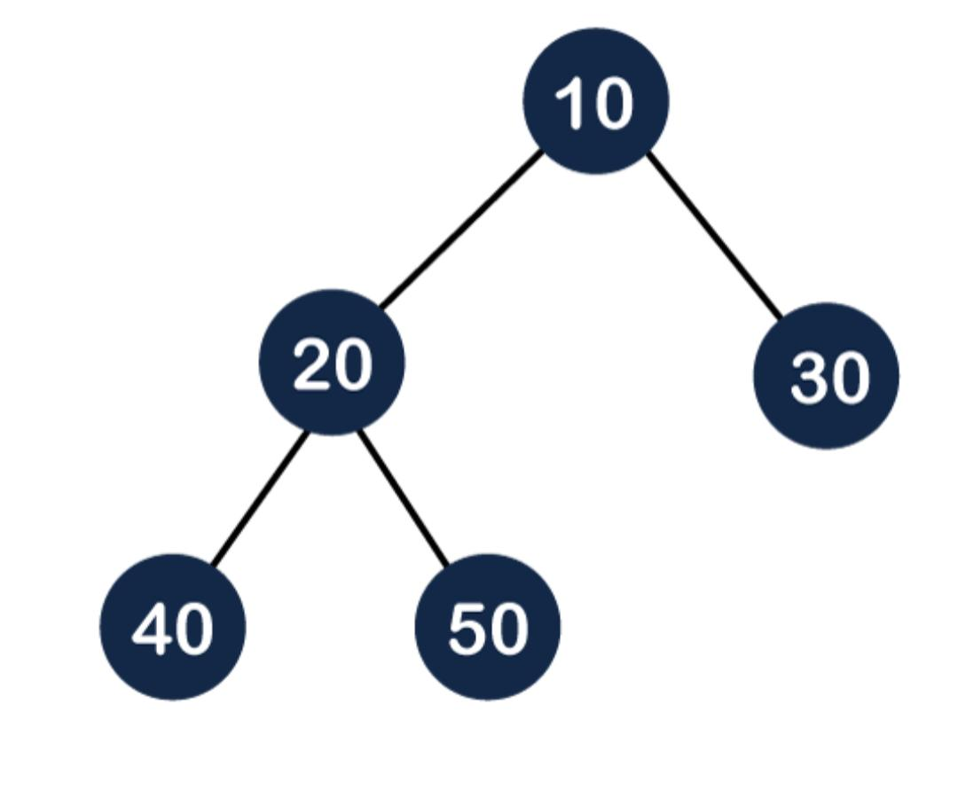
HEAP Tree

Slide 62
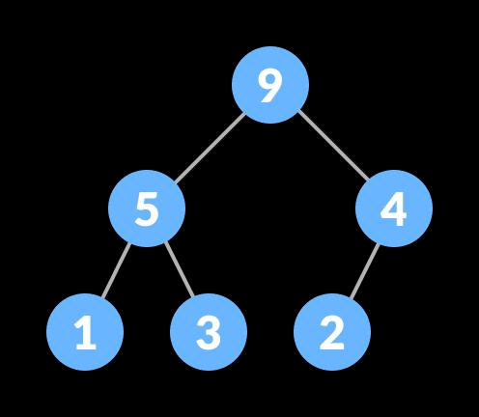
MAX HEAp

Slide 63
HEAP Tree
Heaps can be of two types:
Max-Heap: In a Max-Heap the key present at the root node must be greatest among the keys present at all of it’s children. The same property must be recursively true for all sub-trees in that Binary Tree.
Min-Heap: In a Min-Heap the key present at the root node must be minimum among the keys present at all of it’s children. The same property must be recursively true for all sub-trees in that Binary Tree.

Slide 64
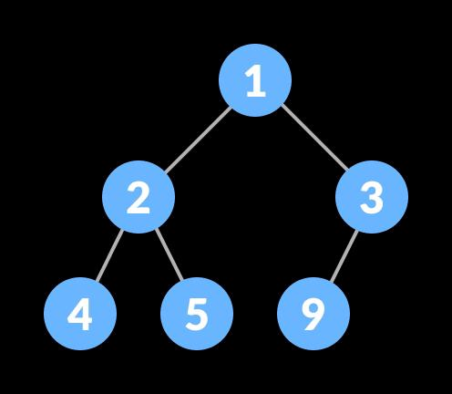
Min heap

Slide 65
Heap tree
Heapify is the process of creating a heap data structure from a binary tree.

Slide 66
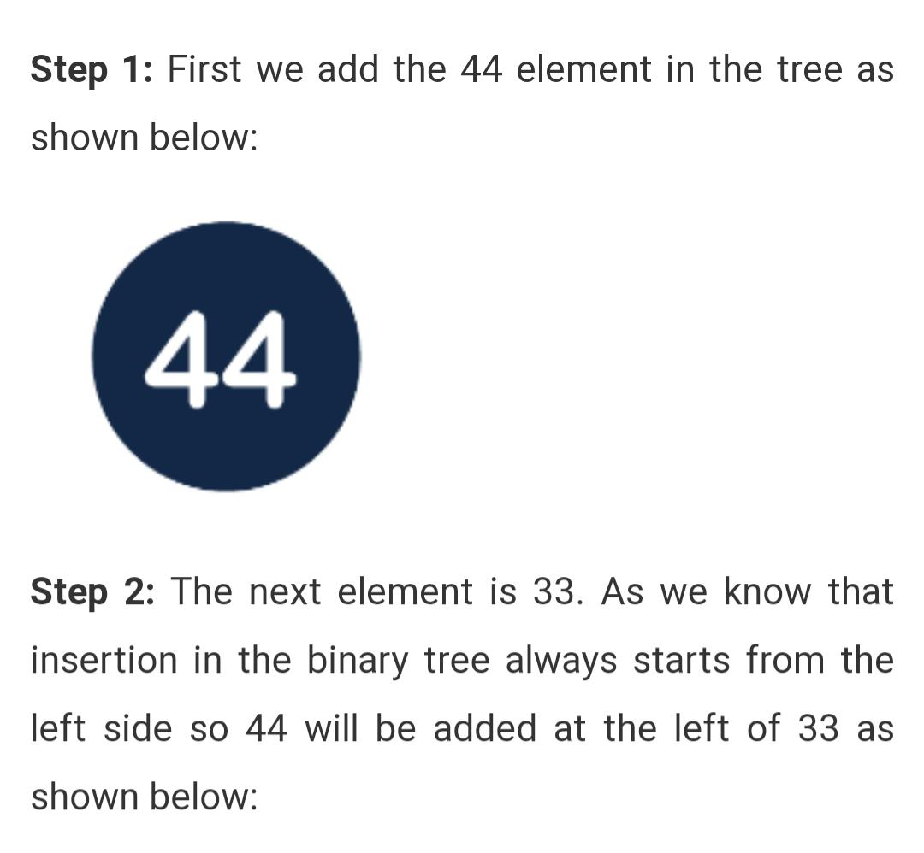
Insertion in the Heap tree 44, 33, 77, 11, 55, 88, 66

Slide 67
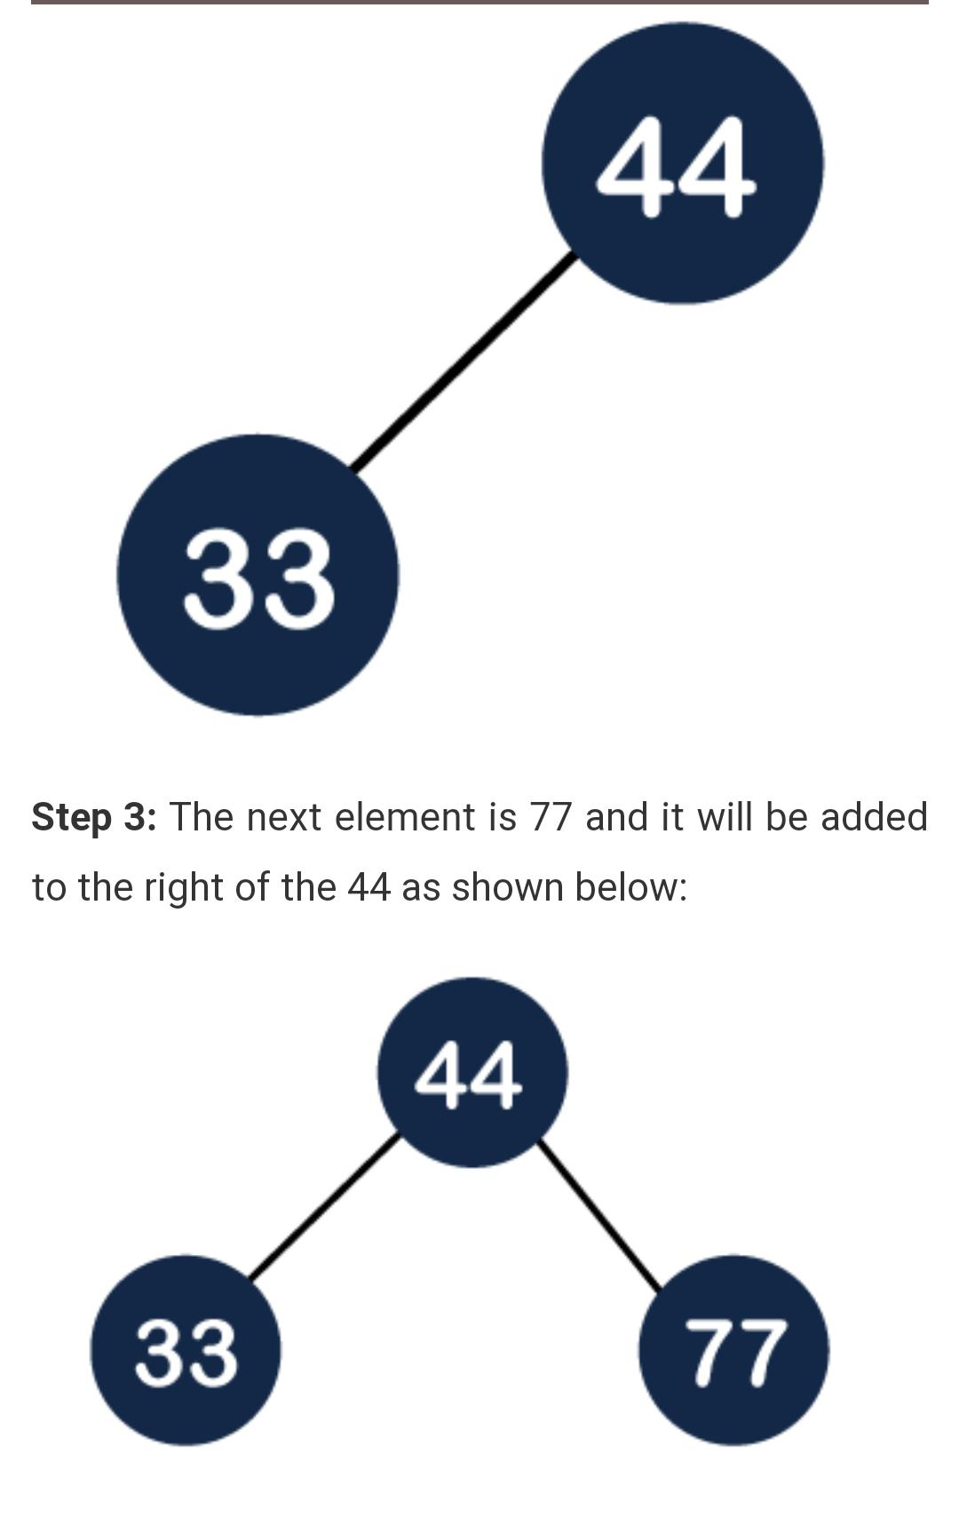
Insertion in the Heap tree 44, 33, 77, 11, 55, 88, 66

Slide 68
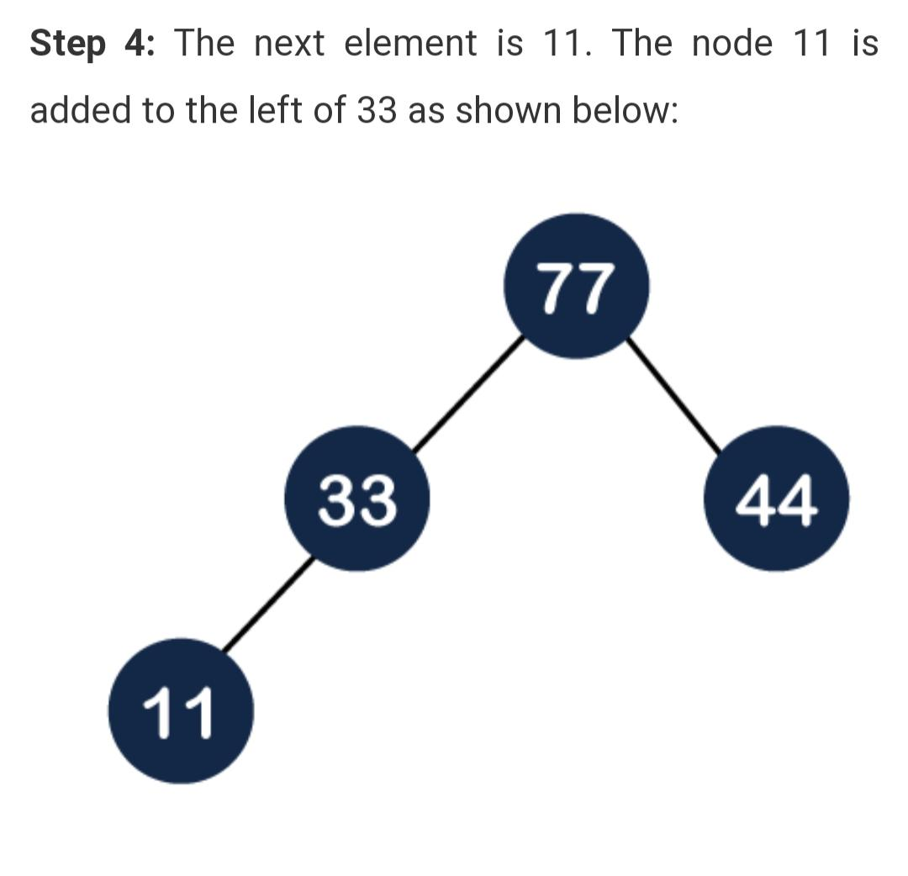

Slide 69
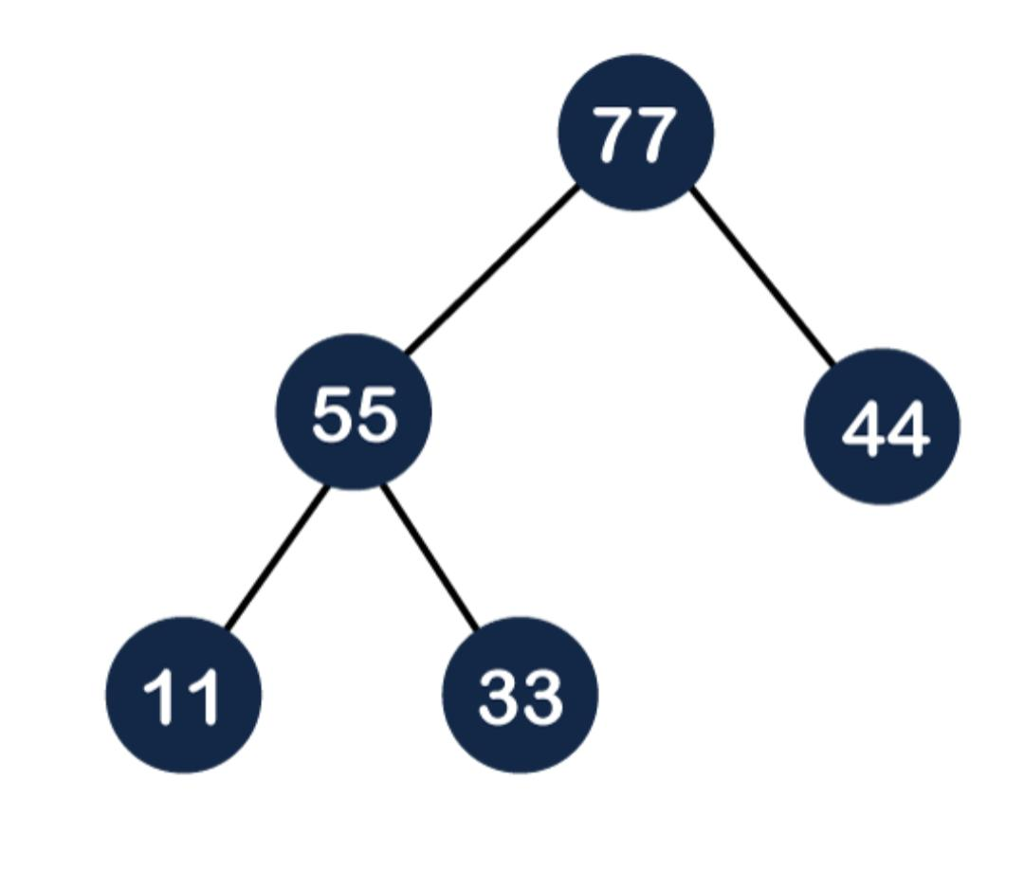

Slide 70
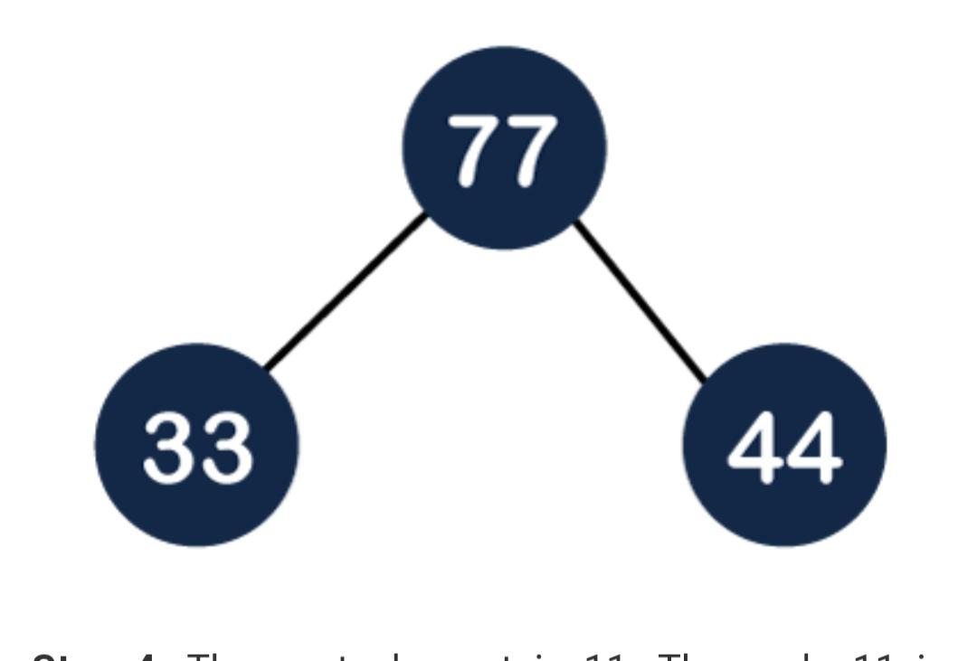

Slide 71
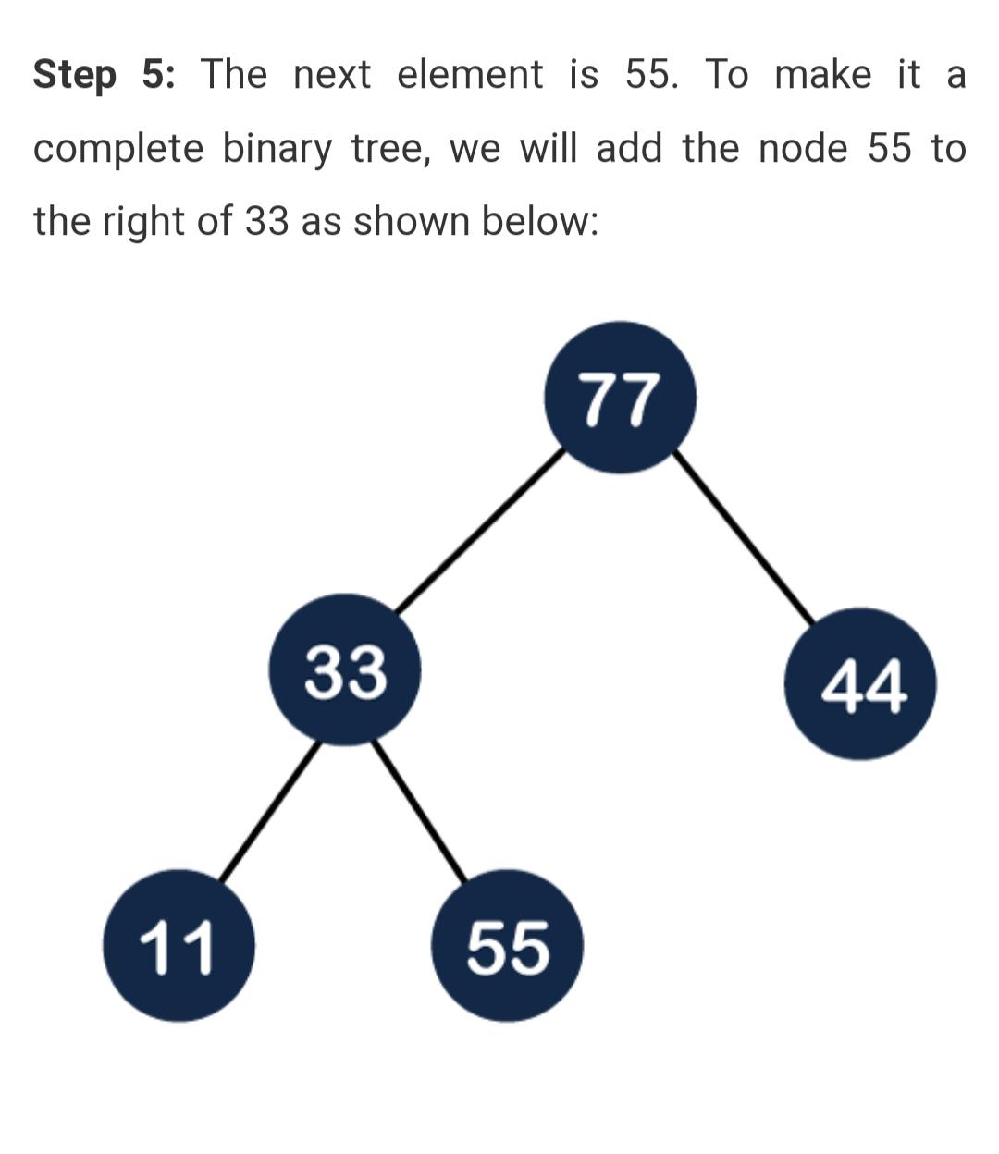

Slide 72
